Slide 1
Presentations start every 20 minutes on strict schedule
15 minutes to present
5 minutes for Q&A
Use any power point design you want
Delete this slide

Slide 2
The PM starts the presentation then turns it over to others who speak in turn
Each person should introduce themselves and speak to a particular section
It’s up to you how you partition this

Slide 3
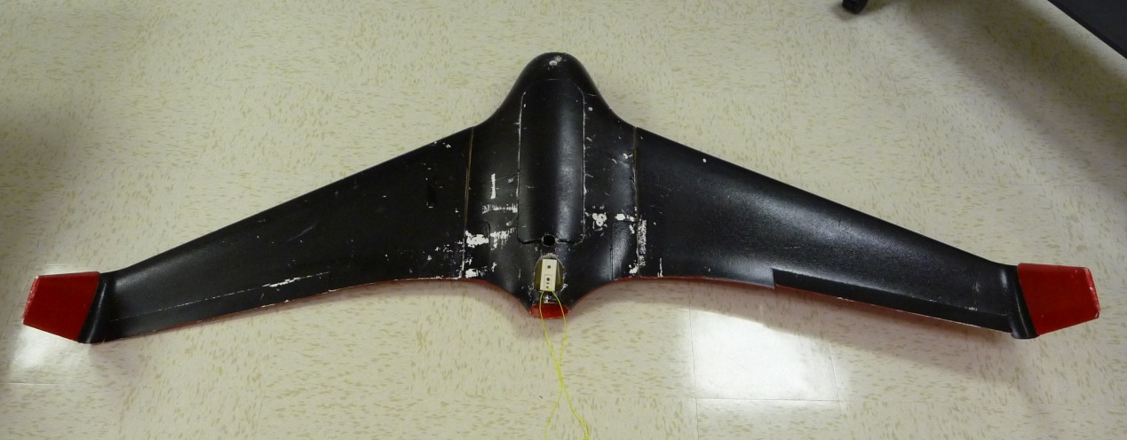
X.Y: Name of Project
Sponsored By: Company Name
Names of team members
Faculty Advisor: Name
Put a picture of your work in place of the photo above
Logo of your sponsoring company (with permission)
Notes:
PM starts presentation. Everyone speaks. You decide who goes when.

Slide 4
WARNING!
The picture on the first slide is to put your project into context.
If it’s a relevant picture you’ll need to show it later and at large size & high res
Notes:
DELETE THIS SLIDE WHEN DONE

Slide 5
Project Overview
What did you design?? Why?
What are the requirements?
What did you deliver? Does it do what it’s supposed to do?

Slide 6
Project Motivation
The problem:
Briefly describe the problem / improvement / need / benefit
No more than 3 bullets
Be concise! Don’t be wordy!
Notes:
Why are you doing this project? What’s important / needed / beneficial about it? Why is this a good senior design project? MAKE FONT BIG

Slide 7
Project Goals
Goals of Project
Stretch Goals of Project
List the major goals here
Be concise
Don’t list too many
List the stretch goals here
Be concise
Don’t list too many
Notes:
If no stretch goals then delete the text box on the right, and expand the one on the left. DO NOT ELABORATE ON THE GOALS, JUST STATE THEM QUICKLY AND MOVE ON!!!

Slide 8
Block Diagrams Example: Auto Cruise Control
Delete these examples when done!
Notes:
DELETE THIS SLIDE WHEN DONE!

Slide 9
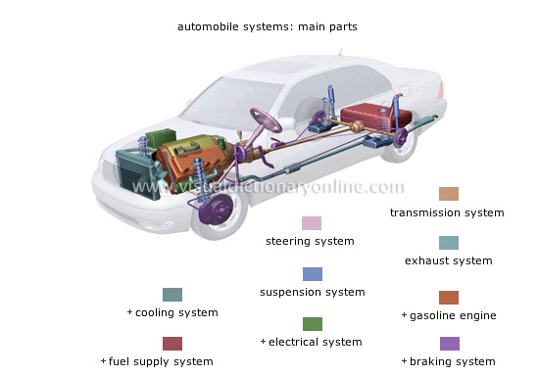
Cruise Control Top Level System
Cruise controls are typically used in an automobile. The driver sets a desired speed and the throttle is varied to stay close to that speed by a control system. One key parameter is how fast the CC responds.
Notes:
Put your project into the larger context.

Slide 10
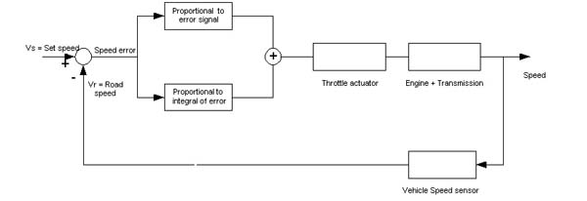
Cruise Control Functional Block Diagram
Automobile applications
Notes:
Show a functional overview of how it works. This applies to software or hardware or mix.

Slide 11
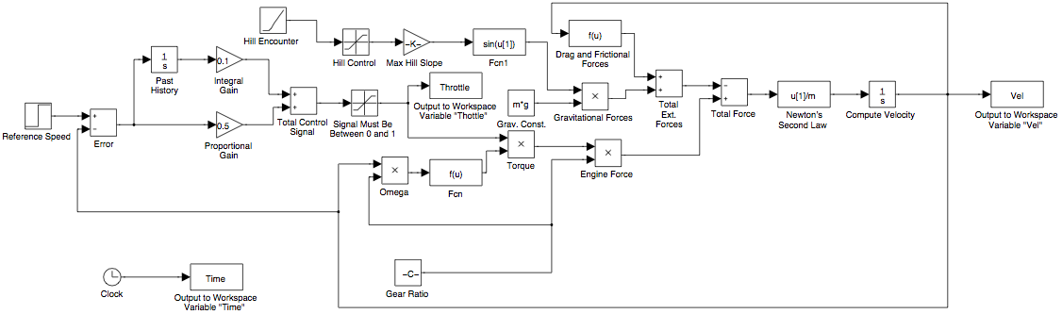
Cruise Control Detail Block Diagram
Give a few lines of detail regarding main features of the system
Notes:
Show deep technical detail. You may need more than one slide. Highlight in yellow the blocks that the team will be designing

Slide 12
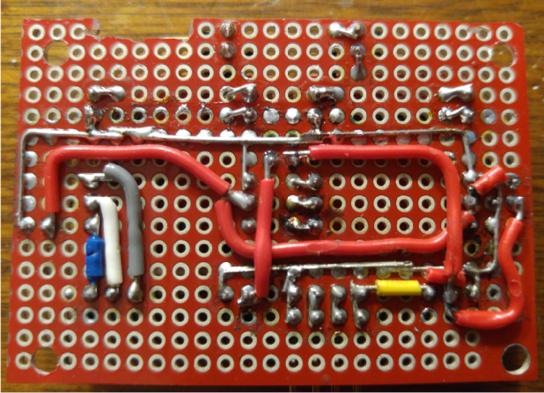
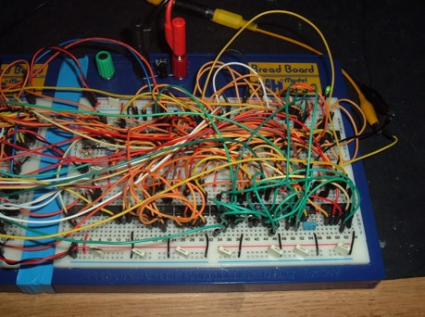
Results
Put photo of your completed work on this slide.
Make it a nice photo.
Look carefully at the background of your photo to make sure there’s nothing distracting.
This
Not This
Notes:
Put in a photo of your completed project.

Slide 13
Data
Put graphs/charts/tables of relevant data
Not too much!!
NOT ALL PROJECTS WILL SHOW DATA

Slide 14
Results
Show a concise table listing each Test Case, its corresponding specification(s), the results of the test, and whether or not it was compliant with the specification.
Notes:
BRIEFLY summarize the results of your efforts in tabular form.

Slide 15
System Deficiencies
List the system deficiencies, if there are any
If not then delete this slide
For each deficiency, list work needed and time required to correct*
* don’t say it will take a day to correct – if that is the case just fix it
Notes:
Delete if you met all goals and all specifications and there were no deficiencies.

Slide 16
Lessons Learned
What did you learn from your capstone experience?
Notes:
Think about this; use it to promote yourselves!

Slide 17
Acknowledgments
Notes:
Be brief!!

